Slide 1
Automation exercise project
DR: Amr Mansour
TA: Lina elnaghi Instructor: ENG/ Abdelrhman Osama
Students :
Antoine maged 20223142(automation testing,api testing)
Omar Mohamed 20223185(automation testing,manual testing)
Mahmoud Sleem 20223978(Manual Testing)
Automation Exercise UI Test Scenarios
13 Aug 2025

Slide 2
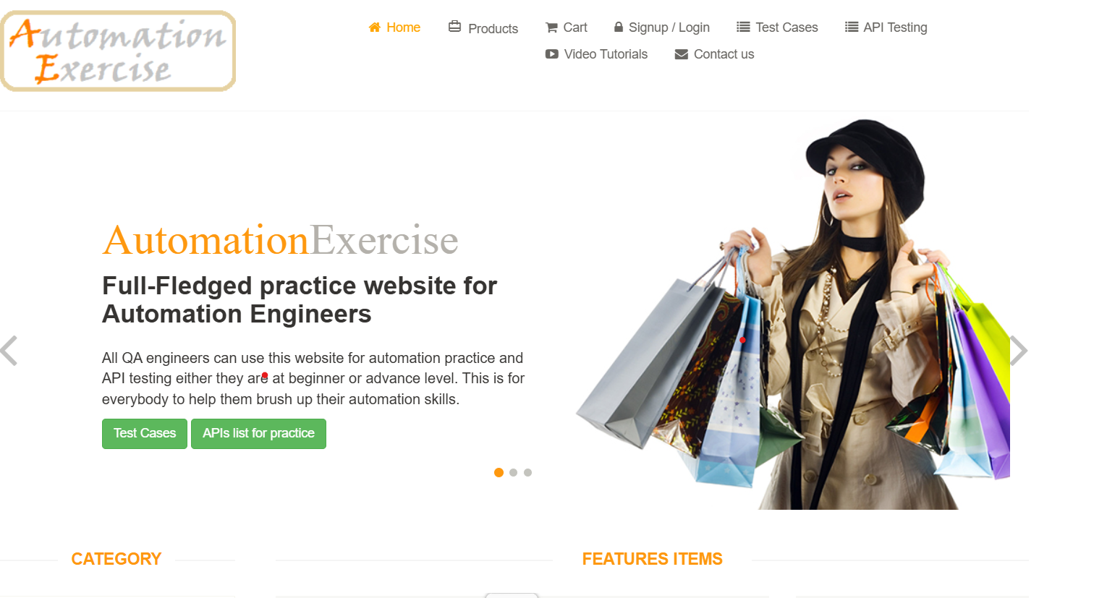
Automation Exercise – UI Test Scenarios
Automation Exercise UI Test Scenarios
13 Aug 2025

Slide 3
Introduction & Approach
Website Description
Automation Exercise is designed as a fully functional e-commerce system, offering a wide range of best practice test cases, APIs, and all the standard features you would expect from a modern e-commerce platform.
Its main purpose is to provide testers with a realistic environment where they can explore, validate, and test all functionalities—from browsing products and managing user accounts to placing orders and interacting with APIs—just as they would on a real-world e-commerce website.
Automation Exercise UI Test Scenarios
13 Aug 2025

Slide 4
Introduction & Brief for Presentation
1. Manual Testing
Manual testing is the process of executing test cases manually without using automation tools, to identify bugs, usability issues, or missing functionalities in the application.
For the Automation Exercise website, manual testing was applied by:
Navigating through different pages and features.
Filling forms, submitting data, and validating responses.
Verifying UI elements, dropdowns, radio buttons, and checkboxes.
Recording results as Pass/Fail according to the expected outcome.
This approach allowed us to understand the website’s behavior and prepare accurate scenarios for automation.
Automation Exercise UI Test Scenarios
13 Aug 2025

Slide 5
How manual testing applies to our website
User Flow Verification : Registering a new user from signup to account creation and deletion.Logging in and logging out with correct/incorrect credentials.automationexercise.com Form Validations: Signup with an existing email to check error messaging. Contact us form submission and file upload flow.automationexercise.com Product and Cart FunctionalityBrowsing : all products, viewing details, and interacting with product search.Adding multiple products to the cart, verifying quantities, and removing items.automationexercise.com Checkout and Order: ProcessingRegistering or logging in during checkout, verifying address, placing orders, and validating success messages.Downloading invoices post-purchase.automationexercise.com Miscellaneous UI Interaction: Subscription validation both on home page and cart page.Scroll up/down functionality, including the "arrow" button at the bottom of the page.automationexercise.com
Automation Exercise UI Test Scenarios
13 Aug 2025

Slide 6
Introduction & Approach
2. Automated Testing
Automated testing uses scripts and frameworks to execute repetitive test cases faster and more efficiently.
For the Automation Exercise website, we automated the prepared manual test cases using:
TestNG for creating and organizing test classes.
Eclipse IDE for coding, compiling, and running test scripts.
JavaScript selectors in specific cases for accurate element targeting.
Page Object Model (POM) to enhance reusability and maintainability.
Data Driven Testing (DDT) to execute tests with multiple sets of data.
Applying automation ensured faster execution, reduced human error, and allowed regression testing across the site.
Automation Exercise UI Test Scenarios
13 Aug 2025

Slide 7
How automated testing applies to our website
Automated Functional Testing (Selenium, Cypress, Playwright, etc.) What happens: Automated test scripts simulate user actions like clicking buttons, filling forms, adding products to the cart, and completing checkout—just as a human tester would—but at machine speed.How it applies to Automation Exercise:The site’s predefined manual test cases can be turned into automated scripts.Example: A Selenium script could automatically: Open the homepage.Navigate to Signup/Login.Fill out registration data.Verify success messages without manual intervention.This speeds up regression testing and ensures functionality is always verified after code changes.
Automation Exercise UI Test Scenarios
13 Aug 2025

Slide 8
Introduction & Approach
3. API Testing
API testing was performed to verify backend services and ensure the APIs returned correct responses and handled edge cases effectively.
For the Automation Exercise APIs, we used:
Postman to send requests and validate responses.
Tested multiple HTTP methods such as GET, POST, PUT, and DELETE.
Verified response codes, payload structures, and error messages.
This helped ensure that the integration points of the e-commerce system were functioning as expected.
Automation Exercise UI Test Scenarios
13 Aug 2025

Slide 9
How API testing applies to our website
API Testing (Postman)
What happens:
Instead of interacting through the browser, scripts send requests directly to the backend APIs (if accessible) to check whether data is being processed correctly.How it applies to Automation Exercise:Some features (e.g., retrieving product lists, validating login, adding to cart) can be tested at the API level.Example: A Postman test could:
Send a GET request to the products API endpoint.Validate the response status, structure, and data values.Run these checks automatically in a collection runner or CI/CD pipeline.This method is faster, more stable than UI tests, and catches backend errors before they surface in the interface.
Automation Exercise UI Test Scenarios
13 Aug 2025

Slide 10
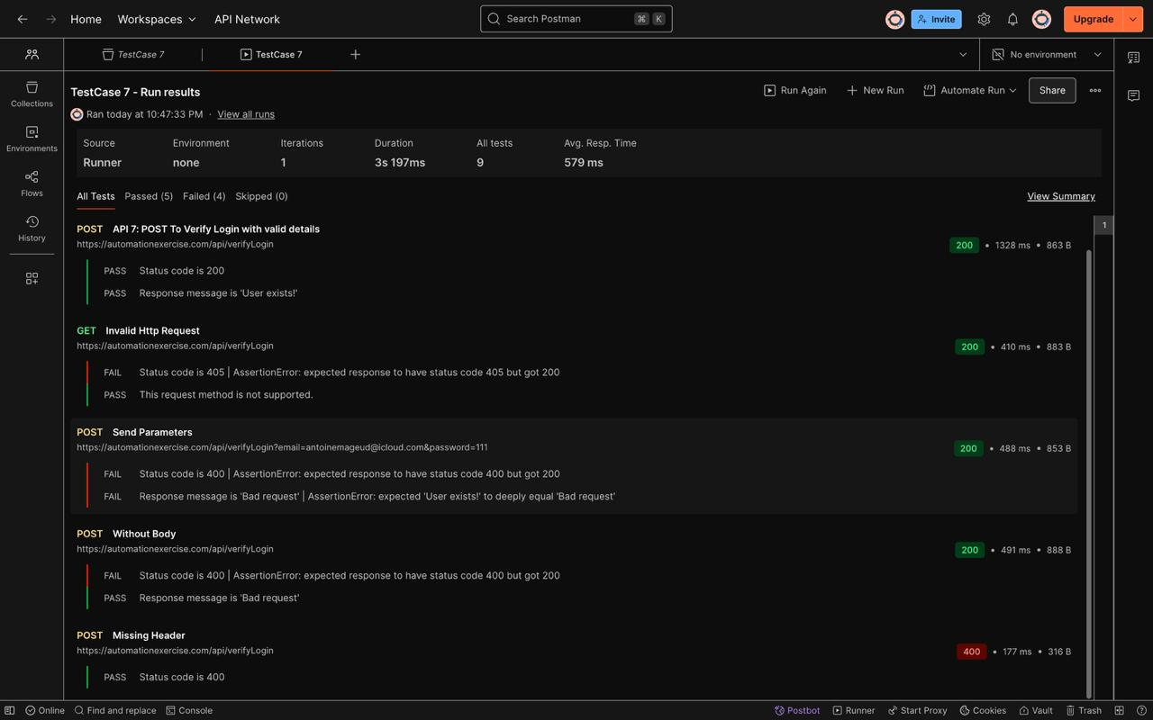
API TEST CASES SCREENSHOTS
Automation Exercise UI Test Scenarios
13 Aug 2025

Slide 11
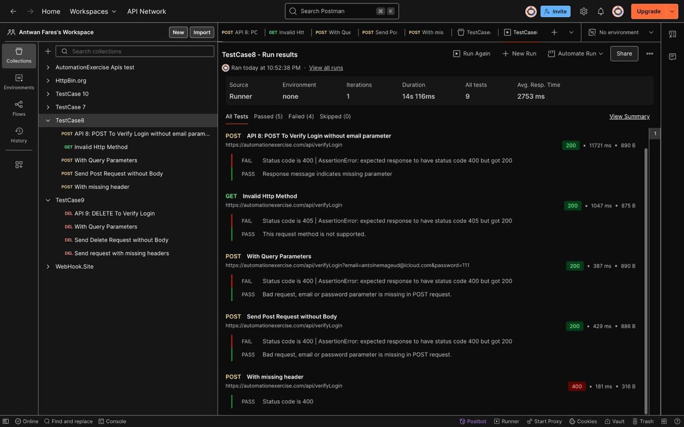
API TEST CASES SCREENSHOT
Automation Exercise UI Test Scenarios
13 Aug 2025

Slide 12
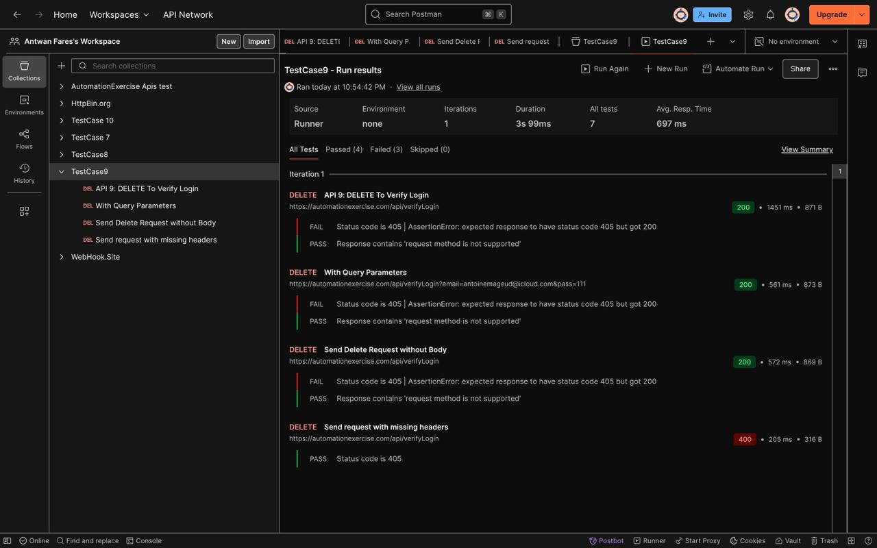
API TEST CASES SCREENSHOTS
Automation Exercise UI Test Scenarios
13 Aug 2025

Slide 13
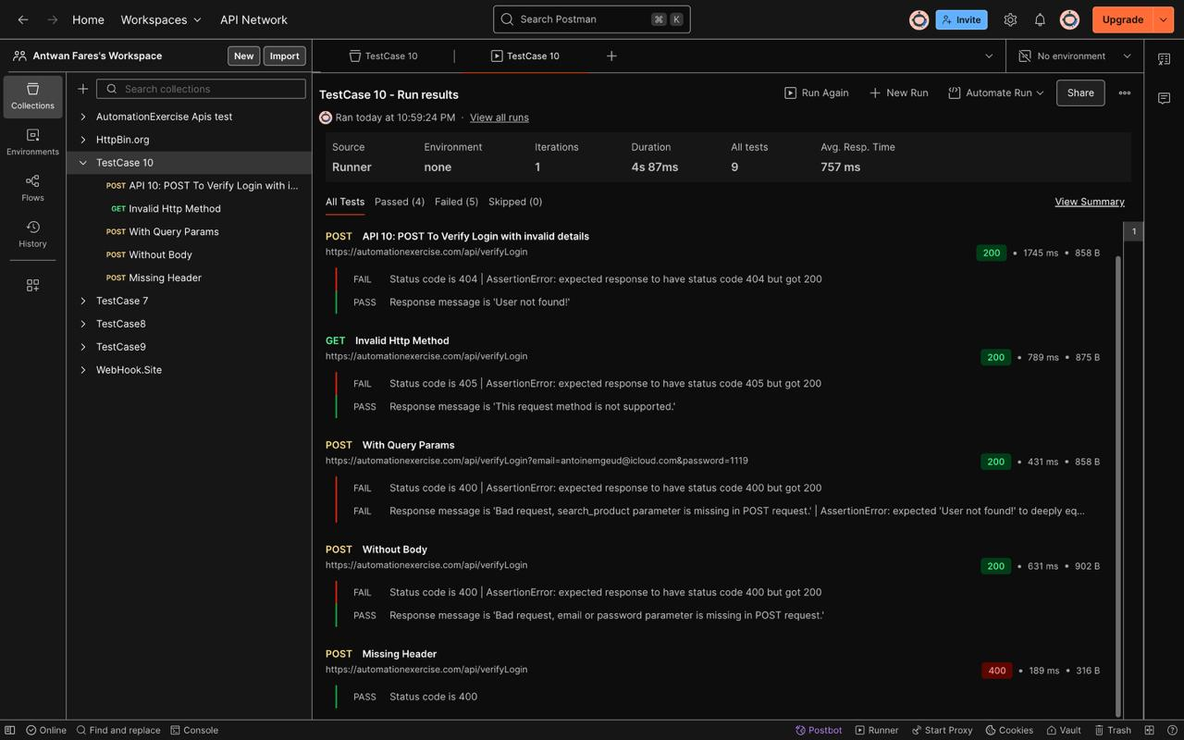
API TEST CASES SCREENSHOTS
Automation Exercise UI Test Scenarios
13 Aug 2025

Slide 14
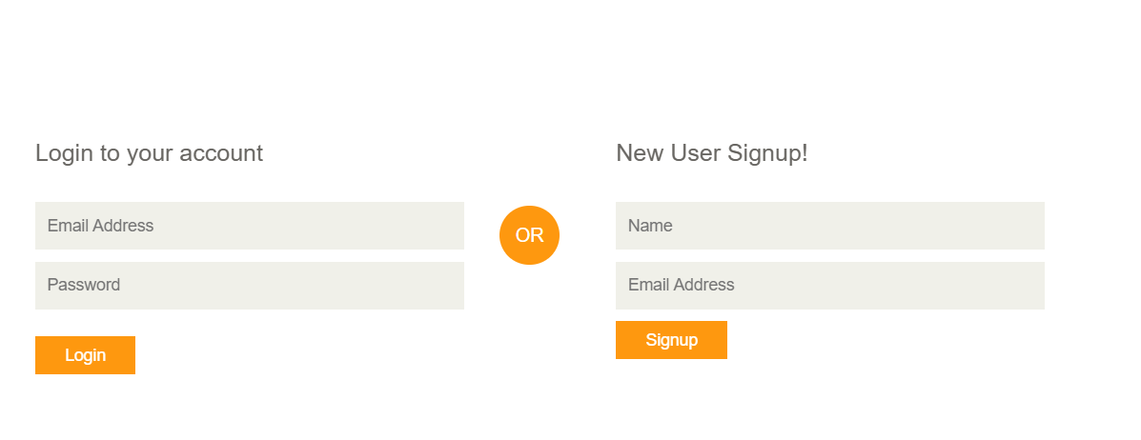
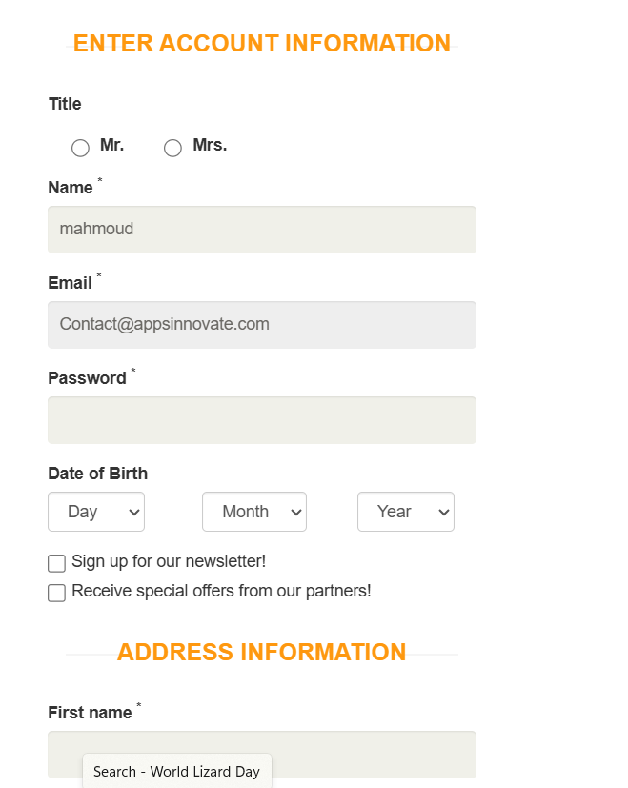
Test Case 1: Register User – Pass – Successful Registration
Objective: Verify a new user can successfully register with valid details.
Steps:
• Go to Home → click 'Signup / Login'.
• Enter name and new unique email → click 'Signup'.
• Fill mandatory details (Title, Password, DOB, Address, Country, State, City, Zip, Mobile).
• Click 'Create Account' → verify 'ACCOUNT CREATED!' → click 'Continue'.
• Verify 'Logged in as <username>' is visible.
Expected: Account is created and user is logged in with 'Logged in as <username>' visible.
[B] Signup/Login page
[D] Account Created banner
Automation Exercise UI Test Scenarios
13 Aug 2025

Slide 15
Test Case 1: Register User – Fail – Missing mandatory fields
Objective: Validate that leaving any mandatory field blank prevents registration.
Steps:
• Repeat steps to open registration form.
• Leave one field blank (iterate: Password / First name / Last name / Address / Country / State / City / Zip / Mobile).
• Click 'Create Account'.
Expected: An inline validation or error prevents account creation; user remains on the form.
Automation Exercise UI Test Scenarios
13 Aug 2025

Slide 16
Test Case 1: Register User – Fail – Invalid email format
Objective: Ensure invalid email addresses are rejected.
Steps:
• Open Signup, enter name and invalid email (e.g., 'test@', 'user@domain', 'user@.com').
• Click 'Signup' → verify error.
Expected: User cannot proceed to details page; error message for invalid email format appears.
[A] Signup with invalid email
[B] Invalid email error message
Automation Exercise UI Test Scenarios
13 Aug 2025

Slide 17
Test Case 1: Register User – Fail – Weak password
Objective: Ensure weak passwords are rejected (e.g., too short, only letters).
Steps:
• Open registration form with valid email.
• Enter weak password (e.g., '12345') and valid values for other fields.
• Click 'Create Account'.
Expected: Error message indicates password policy violation; account is not created.
[A] Password too short
[B] Password error hint/message
Automation Exercise UI Test Scenarios
13 Aug 2025

Slide 18
Test Case 1: Register User – Fail – Country not selected (Dropdown)
Objective: Ensure country is required.
Steps:
• Open registration form.
• Do not select Country (leave default).
• Click 'Create Account'.
Expected: Form shows validation preventing submission due to missing Country.
[A] Country dropdown not selected
[B] Validation preventing submission
Automation Exercise UI Test Scenarios
13 Aug 2025

Slide 19
Test Case 1: Register User – Fail – Invalid mobile number
Objective: Ensure mobile number accepts only valid digits/format.
Steps:
• Enter letters/special characters in Mobile field (e.g., 'abc-123-@@').
• Click 'Create Account'.
Expected: Error is shown for invalid mobile number; submission blocked.
[A] Invalid mobile input
[B] Inline mobile error
Automation Exercise UI Test Scenarios
13 Aug 2025

Slide 20
Test Case 2: Login (Valid credentials) – Pass – Successful Login
Objective: Verify that a registered user can login with valid credentials.
Steps:
• Go to Home → 'Signup / Login'.
• Enter registered email + correct password.
• Click 'Login' → verify home shows 'Logged in as <username>'.
Expected: User is logged in; user name visible in header.
[A] Login form
[B] Logged in header state
Automation Exercise UI Test Scenarios
13 Aug 2025

Slide 21
Test Case 2: Login (Valid credentials) – Fail – Incorrect password
Objective: Ensure incorrect password is rejected.
Steps:
• Open Login page.
• Enter valid email + wrong password.
• Click 'Login'.
Expected: Error 'Your email or password is incorrect!' is displayed.
[A] Wrong password entered
[B] Error banner shown
Automation Exercise UI Test Scenarios
13 Aug 2025

Slide 22
Test Case 2: Login (Valid credentials) – Fail – Unregistered email
Objective: Ensure unregistered email cannot login.
Steps:
• Open Login page.
• Enter non-existent email + any password.
• Click 'Login'.
Expected: Error 'Your email or password is incorrect!' is displayed.
[A] Unregistered email entered
[B] Error banner shown
Automation Exercise UI Test Scenarios
13 Aug 2025

Slide 23
Test Case 2: Login (Valid credentials) – Fail – Invalid email format
Objective: Ensure invalid email format is not accepted.
Steps:
• Open Login page.
• Enter email as 'user@domain' or 'user@.com'.
• Click 'Login'.
Expected: Inline validation or error prevents login.
[A] Invalid email format input
[B] Error message/validation
Automation Exercise UI Test Scenarios
13 Aug 2025

Slide 24
Test Case 3: Login (Invalid credentials) – Fail – Incorrect email & password
Objective: Verify login fails with invalid credentials.
Steps:
• Open Login page.
• Enter incorrect email + incorrect password.
• Click 'Login'.
Expected: Error 'Your email or password is incorrect!' is displayed.
[A] Invalid email & password
[B] Error message
Automation Exercise UI Test Scenarios
13 Aug 2025

Slide 25
Test Case 3: Login (Invalid credentials) – Fail – Blank email and/or password
Objective: Ensure login validation for empty fields.
Steps:
• Open Login page.
• Leave email and/or password blank.
• Click 'Login'.
Expected: Validation appears; login is not performed.
[A] Blank fields
[B] Inline validation
Automation Exercise UI Test Scenarios
13 Aug 2025

Slide 26
Test Case 4: Logout User – Pass – Successful Logout
Objective: Verify that a logged-in user can logout successfully.
Steps:
• Login with valid credentials.
• Click 'Logout'.
• Verify redirected to Login page and 'Logged in as' disappears.
Expected: User is logged out and redirected to the login page.
[A] Logged-in header
[B] After logout – Login page
Automation Exercise UI Test Scenarios
13 Aug 2025

Slide 27
Test Case 4: Logout User – Fail – Logout button not visible
Objective: Ensure the logout control is visible after login.
Steps:
• Login with valid credentials.
• Check header for 'Logout' link/button.
Expected: If missing, it's a defect; user cannot logout.
[A] Header without Logout
[B] Expected Logout control
Automation Exercise UI Test Scenarios
13 Aug 2025

Slide 28
Test Case 4: Logout User – Fail – Session not terminated
Objective: Ensure session is cleared after logout.
Steps:
• Logout successfully.
• Navigate back to protected page via browser Back.
Expected: User should not access authenticated page; should be redirected to login.
[A] Back navigation after logout
[B] Redirect check
Automation Exercise UI Test Scenarios
13 Aug 2025

Slide 29
Test Case 5: Register with existing email – Fail – Existing email address
Objective: Verify that the system prevents duplicate registration using an existing email.
Steps:
• Go to 'Signup / Login'.
• Enter name + an already registered email.
• Click 'Signup'.
Expected: Error 'Email Address already exist!' is displayed.
[A] Existing email entered
[B] Error banner shown
Automation Exercise UI Test Scenarios
13 Aug 2025

Slide 30
Test Case 5: Register with existing email – Fail – Case sensitivity / whitespace
Objective: Check for email normalization issues.
Steps:
• Enter same email with different case (e.g., USER@MAIL.com).
• Enter email with trailing spaces.
• Click 'Signup'.
Expected: Duplicate detection still triggers error message.
[A] Uppercase email
[B] Email with spaces
Automation Exercise UI Test Scenarios
13 Aug 2025

Slide 31
Test Case 6: Contact Us Form – Pass – Submit with valid data & file upload
Objective: Verify that the contact form submits successfully with valid data.
Steps:
• Go to 'Contact us'.
• Fill Name, Email, Subject, Message.
• Upload a small valid file (e.g., .png).
• Click 'Submit' and accept alert.
• Verify success message is displayed.
Expected: Success confirmation message appears.
[A] Contact form filled
[B] Success confirmation
Automation Exercise UI Test Scenarios
13 Aug 2025

Slide 32
Test Case 6: Contact Us Form – Fail – Missing required fields
Objective: Verify that each required field is validated individually.
Steps:
• Iterate missing fields: Name / Email / Subject / Message.
• Try to submit.
Expected: Inline errors or alerts prevent submission.
[A] Missing Name
[B] Missing Subject
[C] Missing Message
Automation Exercise UI Test Scenarios
13 Aug 2025

Slide 33
Test Case 6: Contact Us Form – Fail – Invalid email format
Objective: Ensure invalid email format is rejected.
Steps:
• Enter invalid email in Email field.
• Submit the form.
Expected: Form shows email validation error.
[A] Invalid email entered
[B] Email validation message
Automation Exercise UI Test Scenarios
13 Aug 2025

Slide 34
Test Case 6: Contact Us Form – Fail – Invalid attachment type/size
Objective: Ensure only valid file types/sizes are accepted.
Steps:
• Upload an unsupported file type or a very large file.
• Submit the form.
Expected: Error shown; submission blocked.
[A] Invalid file chosen
[B] Error message for file
Automation Exercise UI Test Scenarios
13 Aug 2025

Slide 35
Test Case 7: Verify – Test Cases Page – Pass – Page list visible
Objective: Verify that the Test Cases page loads and lists all scenarios.
Steps:
• Open 'Test Cases' from header.
• Verify headings and list items are visible.
Expected: All test cases are displayed correctly.
[A] Test Cases page
[B] List items visible
Automation Exercise UI Test Scenarios
13 Aug 2025

Slide 36
Test Case 7: Verify – Test Cases Page – Fail – Broken/slow page
Objective: Verify resilience to performance or broken links.
Steps:
• Open 'Test Cases'.
• Check for broken links and excessive load time.
Expected: No broken links; acceptable load time (<3s).
[A] Loading spinner
[B] Link click error
Automation Exercise UI Test Scenarios
13 Aug 2025

Slide 37
Test Case 8: All Products & Product Detail – Pass – Product list & detail visible
Objective: Verify products page lists items and product detail opens.
Steps:
• Open 'Products'.
• Verify product cards present.
• Open a product detail; verify title, price, availability, condition, brand.
Expected: Product list and detail information are visible.
[A] Products grid
[B] Product detail page
Automation Exercise UI Test Scenarios
13 Aug 2025

Slide 38
Test Case 8: All Products & Product Detail – Fail – Missing product info
Objective: Ensure all key product attributes are present.
Steps:
• Open product detail and verify: title/price/availability/condition/brand.
• If any is missing, mark as defect.
Expected: All attributes should be present; otherwise, fail.
[A] Detail missing price
[B] Detail missing brand
Automation Exercise UI Test Scenarios
13 Aug 2025

Slide 39
Test Case 9: Search Product – Pass – Search returns correct items
Objective: Verify that search filters products by keyword.
Steps:
• Open 'Products'.
• Enter a keyword (e.g., 'dress') in search and submit.
• Verify results contain the keyword.
Expected: Only relevant products are displayed; 'SEARCHED PRODUCTS' heading visible.
[A] Search field
[B] Results grid filtered
Automation Exercise UI Test Scenarios
13 Aug 2025

Slide 40
Test Case 9: Search Product – Fail – No results / wrong results
Objective: Verify correct handling of empty or unrelated queries.
Steps:
• Search with gibberish text (e.g., 'zzzxxx').
• Search with leading/trailing spaces and mixed case.
Expected: No results message or empty state is shown appropriately.
[A] No results state
[B] Edge-case search input
Automation Exercise UI Test Scenarios
13 Aug 2025

Slide 41
Test Case 10: Verify Subscription – Home Page – Pass – Subscribe with valid email
Objective: Verify home page newsletter subscription field works.
Steps:
• At bottom of Home page, locate subscription field.
• Enter valid email and submit.
Expected: Success message is shown for subscription.
[A] Subscription field
[B] Success message
Automation Exercise UI Test Scenarios
13 Aug 2025

Slide 42
Test Case 10: Verify Subscription – Home Page – Fail – Invalid email
Objective: Verify invalid email is rejected.
Steps:
• Enter malformed email (e.g., 'user@domain').
• Submit.
Expected: Error message is displayed; no subscription created.
[A] Invalid email input
[B] Error message
Automation Exercise UI Test Scenarios
13 Aug 2025

Slide 43
Test Case 11: Verify Subscription – Cart Page – Pass – Subscribe in Cart
Objective: Verify subscription works from cart page footer.
Steps:
• Add any product to cart; go to 'Cart'.
• Use subscription field in footer with valid email.
Expected: Success message is shown.
[A] Cart footer subscription
[B] Subscription success
Automation Exercise UI Test Scenarios
13 Aug 2025

Slide 44
Test Case 11: Verify Subscription – Cart Page – Fail – Invalid email in cart footer
Objective: Ensure invalid email is rejected in cart footer as well.
Steps:
• Enter malformed email in cart page subscription.
• Submit.
Expected: Error message is displayed.
[A] Invalid email input
[B] Error message
Automation Exercise UI Test Scenarios
13 Aug 2025

Slide 45
Test Case 12: Add Products in Cart – Pass – Add multiple products
Objective: Verify that products can be added to the cart and appear correctly.
Steps:
• Open 'Products'.
• Add two different products to cart.
• Open cart and verify names, prices, qty, and totals.
Expected: Cart shows selected products with correct totals.
[A] Add to cart (product A)
[B] Add to cart (product B)
[C] Cart with items
Automation Exercise UI Test Scenarios
13 Aug 2025

Slide 46
Test Case 12: Add Products in Cart – Fail – Incorrect totals/quantity
Objective: Verify cart math and quantity updates.
Steps:
• Add products; update quantity in cart.
• Verify subtotal and total update correctly.
Expected: Totals must equal sum(qty × unit price).
[A] Update quantity
[B] Verify total calculation
Automation Exercise UI Test Scenarios
13 Aug 2025

Slide 47
How to Capture Screenshots (Guide)
Screenshot Tips:
• Use Chrome in 100% zoom and maximize the window for consistency.
• Before/After: capture the state before clicking and the state after validation.
• Annotate with arrows/rectangles showing field names, errors, and banners.
• Name files by case and step, e.g., TC1_Pass_A_Home.png, TC1_Fail_MissingName_B_Error.png.
• For long forms (TC1, TC6), take multiple partial screenshots (top/middle/bottom).
Automation Exercise UI Test Scenarios
13 Aug 2025

Slide 48
Test Case 13: Remove Products From Cart – Pass – Remove single product
Objective: Verify that user can remove a product from the cart successfully.
Steps:
• Add a product to cart.
• Go to cart page.
• Click 'X' remove button for that product.
Expected: Product is removed from cart; cart updates accordingly.
[A] Cart with product
[B] After removal – empty cart
Automation Exercise UI Test Scenarios
13 Aug 2025

Slide 49
Test Case 13: Remove Products From Cart – Fail – Product still visible after removal
Objective: Ensure product disappears from cart after removal.
Steps:
• Add product, remove it from cart.
• Refresh cart page.
Expected: Product should not reappear; if it does, it's a defect.
[A] Removal action
[B] Product reappears after refresh
Automation Exercise UI Test Scenarios
13 Aug 2025

Slide 50
Test Case 14: Verify Category Products – Pass – Filter by category
Objective: Verify category selection filters products correctly.
Steps:
• Go to Products page.
• Click a category from sidebar.
• Verify only products from that category are displayed.
Expected: Filtered products belong to the selected category.
[A] Category sidebar
[B] Filtered results
Automation Exercise UI Test Scenarios
13 Aug 2025

Slide 51
Test Case 14: Verify Category Products – Fail – Irrelevant products shown
Objective: Ensure category filter does not show products from other categories.
Steps:
• Select category.
• Check all displayed products belong to selected category.
Expected: No irrelevant products should be displayed.
[A] Category filter active
[B] Irrelevant product present
Automation Exercise UI Test Scenarios
13 Aug 2025

Slide 52
Test Case 15: Verify Brand Products – Pass – Filter by brand
Objective: Verify that selecting a brand shows only its products.
Steps:
• Go to Products page.
• Click a brand from sidebar.
• Verify listed products belong to the selected brand.
Expected: Only selected brand's products are displayed.
[A] Brand sidebar
[B] Filtered brand results
Automation Exercise UI Test Scenarios
13 Aug 2025

Slide 53
Test Case 15: Verify Brand Products – Fail – Wrong products in brand filter
Objective: Ensure brand filter does not display unrelated products.
Steps:
• Select a brand.
• Check displayed products; note any not belonging to brand.
Expected: No unrelated products should appear.
[A] Brand filter active
[B] Unrelated product shown
Automation Exercise UI Test Scenarios
13 Aug 2025

Slide 54
Test Case 16: Add Review on Product – Pass – Submit valid review
Objective: Verify user can submit a review with all required fields.
Steps:
• Open a product detail page.
• Fill name, email, review text.
• Submit review.
Expected: Review submission confirmation is displayed.
[A] Review form filled
[B] Success message
Automation Exercise UI Test Scenarios
13 Aug 2025

Slide 55
Test Case 16: Add Review on Product – Fail – Missing required field
Objective: Ensure missing any required field blocks submission.
Steps:
• Open review form.
• Leave name/email/review blank and submit.
Expected: Validation prevents submission; error shown.
[A] Missing name
[B] Error message
Automation Exercise UI Test Scenarios
13 Aug 2025

Slide 56
Test Case 17: Add to Cart – Recommended Items – Pass – Add recommended product
Objective: Verify user can add recommended items to cart.
Steps:
• Scroll to Recommended Items section.
• Click 'Add to cart' for a product.
• Verify it appears in cart.
Expected: Product added successfully to cart.
[A] Recommended section
[B] Cart with item
Automation Exercise UI Test Scenarios
13 Aug 2025

Slide 57
Test Case 17: Add to Cart – Recommended Items – Fail – Item not added
Objective: Ensure clicking 'Add to cart' adds item to cart.
Steps:
• Click 'Add to cart' on recommended item.
• Check cart; item missing.
Expected: If item missing, it's a defect.
[A] Click add
[B] Cart missing item
Automation Exercise UI Test Scenarios
13 Aug 2025

Slide 58
Test Case 18: Verify Address Details – Checkout – Pass – Correct address displayed
Objective: Verify checkout shows user's correct billing and delivery addresses.
Steps:
• Login, add product to cart, proceed to checkout.
• Check displayed billing & delivery addresses.
Expected: Addresses match user's profile.
[A] Checkout address section
[B] Matching profile address
Automation Exercise UI Test Scenarios
13 Aug 2025

Slide 59
Test Case 18: Verify Address Details – Checkout – Fail – Incorrect address shown
Objective: Ensure addresses in checkout are accurate.
Steps:
• Proceed to checkout.
• Compare addresses to user's profile.
Expected: Mismatch indicates defect.
[A] Address mismatch
[B] Profile address
Automation Exercise UI Test Scenarios
13 Aug 2025

Slide 60
Test Case 19: Download Invoice – Pass – Invoice downloads
Objective: Verify user can download invoice after purchase.
Steps:
• Place order.
• Click 'Download Invoice'.
• Verify file downloads.
Expected: Invoice file is downloaded successfully.
[A] Download link
[B] Invoice PDF
Automation Exercise UI Test Scenarios
13 Aug 2025

Slide 61
Test Case 19: Download Invoice – Fail – Invoice not downloading
Objective: Ensure invoice link works.
Steps:
• Click 'Download Invoice'.
• Check if file is downloaded.
Expected: If no file, it's a defect.
[A] Click link
[B] No file download
Automation Exercise UI Test Scenarios
13 Aug 2025

Slide 62
Test Case 20: Scroll Up – Arrow Button – Pass – Scrolls to top
Objective: Verify clicking arrow button scrolls to top.
Steps:
• Scroll down.
• Click up-arrow button.
• Verify page scrolls to top.
Expected: Page returns to top.
[A] Scroll down
[B] After scroll up
Automation Exercise UI Test Scenarios
13 Aug 2025

Slide 63
Test Case 20: Scroll Up – Arrow Button – Fail – No scroll
Objective: Ensure arrow button works.
Steps:
• Click arrow.
• Check if page scrolls.
Expected: If no scroll, defect.
[A] Click arrow
[B] No scroll
Automation Exercise UI Test Scenarios
13 Aug 2025

Slide 64
Test Case 21: Scroll Up – Without Arrow – Pass – Manual scroll works
Objective: Verify manual scrolling returns to top.
Steps:
• Scroll down.
• Manually scroll up.
• Verify top reached.
Expected: Page at top position.
[A] Manual scroll
[B] At top
Automation Exercise UI Test Scenarios
13 Aug 2025

Slide 65
Test Case 21: Scroll Up – Without Arrow – Fail – Cannot scroll manually
Objective: Ensure manual scroll works.
Steps:
• Try manual scroll up.
• Verify movement.
Expected: If no movement, defect.
[A] Try scroll
[B] No movement
Automation Exercise UI Test Scenarios
13 Aug 2025

Slide 66
Test Case 22: Add to Cart – Search Results – Pass – Add found product
Objective: Verify user can add product from search results.
Steps:
• Search for a product.
• Click 'Add to cart'.
• Verify it appears in cart.
Expected: Product appears in cart.
[A] Search results
[B] Cart with product
Automation Exercise UI Test Scenarios
13 Aug 2025

Slide 67
Test Case 22: Add to Cart – Search Results – Fail – Add fails
Objective: Ensure adding from search results works.
Steps:
• Click 'Add to cart' on result.
• Check cart.
Expected: If missing, defect.
[A] Click add
[B] Missing in cart
Automation Exercise UI Test Scenarios
13 Aug 2025

Slide 68
Test Case 23: Place Order – Login Before Checkout – Pass – Order placed
Objective: Verify logged-in user can place order.
Steps:
• Login, add product, checkout.
• Enter payment details.
• Place order.
Expected: Order placed; confirmation shown.
[A] Checkout page
[B] Order confirmation
Automation Exercise UI Test Scenarios
13 Aug 2025

Slide 69
Test Case 23: Place Order – Login Before Checkout – Fail – Payment fails
Objective: Ensure payment processes correctly.
Steps:
• Enter invalid payment details.
• Place order.
Expected: Error shown; order not placed.
[A] Invalid payment
[B] Error message
Automation Exercise UI Test Scenarios
13 Aug 2025

Slide 70
Test Case 24: Place Order – Register Before Checkout – Pass – Registration + order
Objective: Verify new user can register and place order.
Steps:
• Add product, proceed to checkout.
• Register during checkout.
• Enter payment details; place order.
Expected: Order placed; confirmation shown.
[A] Registration during checkout
[B] Order confirmation
Automation Exercise UI Test Scenarios
13 Aug 2025

Slide 71
Test Case 24: Place Order – Register Before Checkout – Fail – Registration fails
Objective: Ensure registration during checkout works.
Steps:
• Attempt to register with existing email during checkout.
• Verify error; cannot proceed.
Expected: Error for existing email; no order placed.
[A] Existing email
[B] Error message
Automation Exercise UI Test Scenarios
13 Aug 2025

